Slide 1
Algorithms and data structures
December 2018

Slide 2
Agenda
Asymptotic analysis
Fundamentals of algorithm analysis
Basic data structures
Data structures for grown-ups
Binary trees
Searching
Linear and Binary search
DND
Balanced tree
Hashing and maps
Graphs

Slide 3
Asymptotic analysis
EA 2018

Slide 4
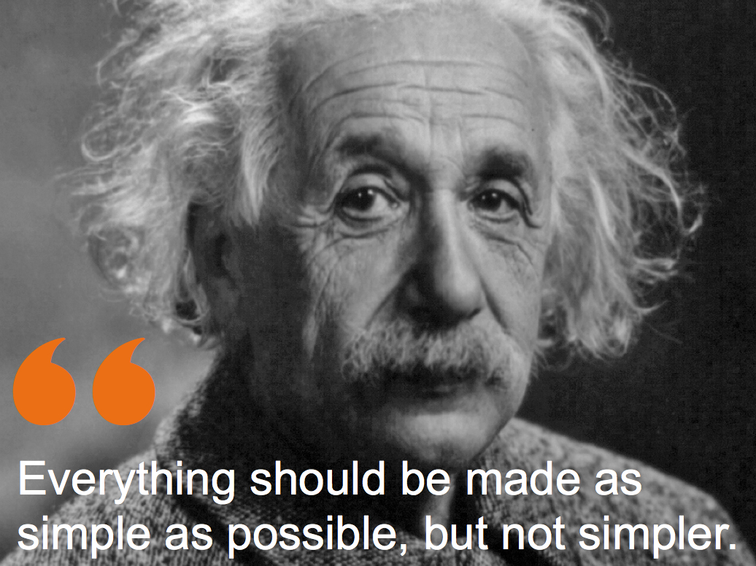
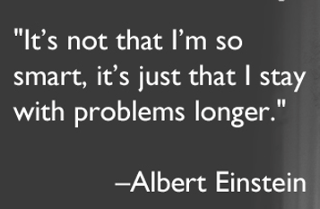
Let’s begin

Slide 5
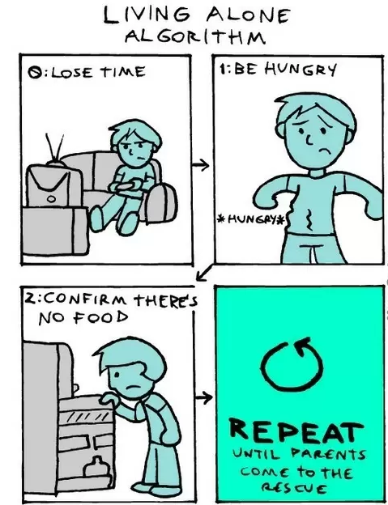
Basic definitions

Slide 6
Basic definitions
A finite set of instructions that specify a sequence of operations to be carried out in order to solve a specific problem (or class of problems). It’s not a recipe.
We require a finite number of instructions.
Each step must have only one interpretation.
We need a clear sequence.
Inputs and outputs have to be specified.
Each instruction should be performed individually.

Slide 7
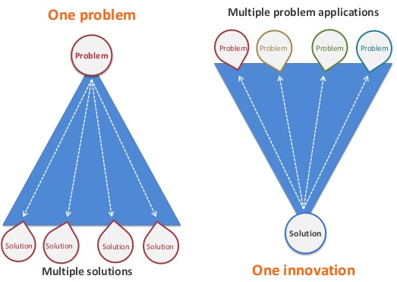
Asymptotic analysis
The design should consider that there are multiple solutions, but there’s some tradeoff between them.
Create an efficient algorithm that uses optimally the resources
Function like 2^{n} is not even worth it

Slide 8
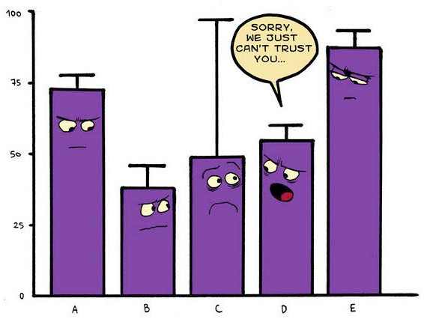
Before we continue
The program can make the algorithm look poor
The result depends on hardware for benchmarking, OS, programing language and etc.
The choice of the test data may influence the algorithm’s behaviour

Slide 9
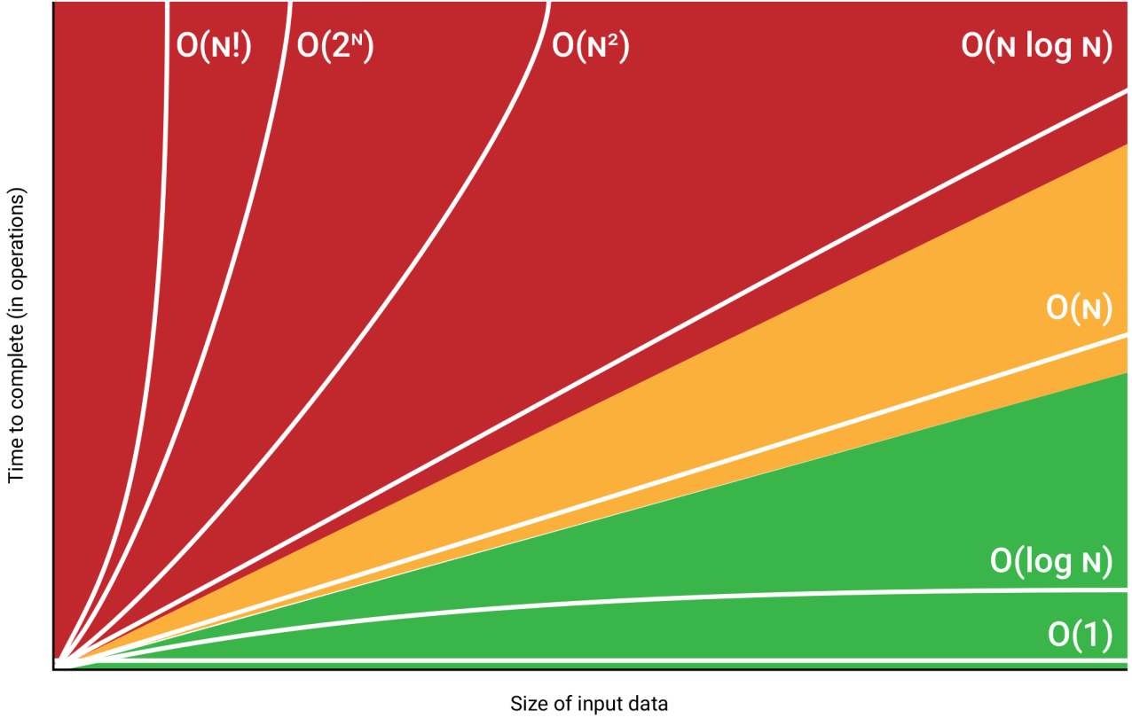
So what’s asymptotic and what’s analysis?
Complexity analysis – systematic study of the cost for a computation, measured either in time units, operations performed or in the amount of required storage space.
Algorithm analysis – produces a function, for example O(N), which measures the complexity.
Order of magnitude -> asymptotic analysis – analysis of O(N) to determine the general complexity category:

Slide 10
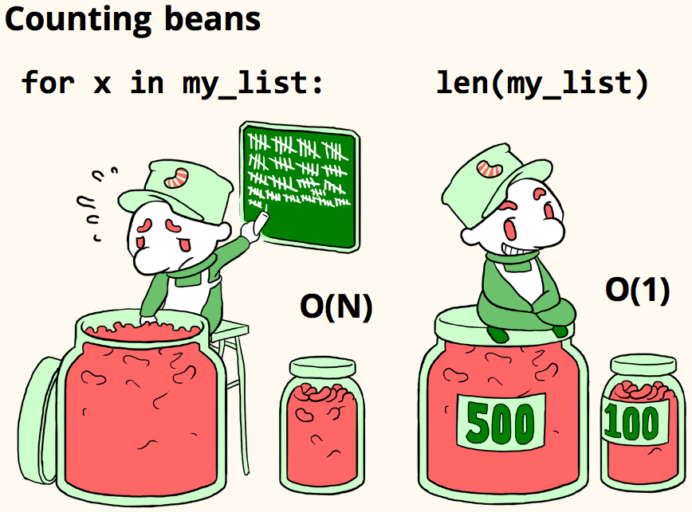
Asymptotic analysis

Slide 11

If you still don’t get it:
Let’s have a hardware, which executes 10⁶ instructions per second.
Let’s have a function T(N) = N², where N = 10⁸.
Let’s do the math:
T(10⁸) = (10⁸)² = 10¹⁶
Total number of seconds required: T(10⁸) / 10⁶
Running time = 10¹⁶ / 10⁶ = 10¹⁰
Each day has 86 400 seconds, so we need 115 740 days, e.g. 317 years.

Slide 12

If you still don’t get it:
Now what happens if we have the NlogN function instead of N².

Slide 13

What’s asymptotic? What’s analysis?
f(n) | N = 10³ | N = 10⁵ | N = 10⁶
log(N) | 10⁻⁵ sec | 1.7 * 10⁻⁵ sec | 2 * 10⁻⁵ sec
N | 10⁻³ | 0.1 sec | 1 sec
N*log(N) | 0.01 sec | 1.7 sec | 20 sec
N² | 1 sec | 3 h | 12 days
N³ | 17 min | 32 years | 317 centuries
2^{n} | 10²⁸⁵ centuries | 10¹⁰⁰⁰⁰ years | 10¹⁰⁰⁰⁰⁰ years

Slide 14



What do we target?

Slide 15
Fundamentals of algorithm analysis
EA 2018

Slide 16
Let’s sum-up
We need an arbitrary unit – for example time.
We assume that the following operations take 1 unit:
Assignment operation
Single I/O operation
Single boolean operations or comparisons
Single arithmetic operations
Function return
Array indexing or pointer dereferencing
if or switch = number of conditions + number of branches
All operations of the loop * number of iterations

Slide 17
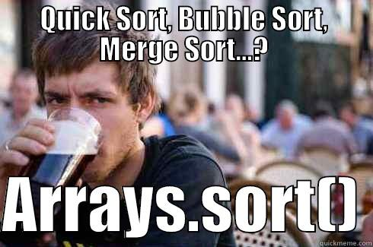
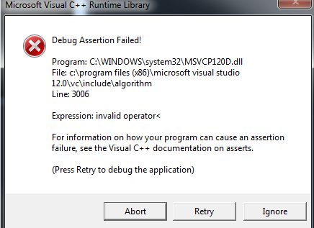
Sorting… good
Example for a simple task humans do
Example for a simple task humans do and alien to the way they think
Why bother, we have std::sort()?

Slide 18
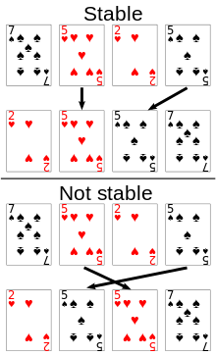
Sorting… how
Comparison criteria
Stability - a stable sort will leave identical keys (values) in the same relative position in the sorted output, e.g. whenever there are two records R and S with the same key and with R appearing before S in the original list, R will appear before S in the sorted list.

Slide 19
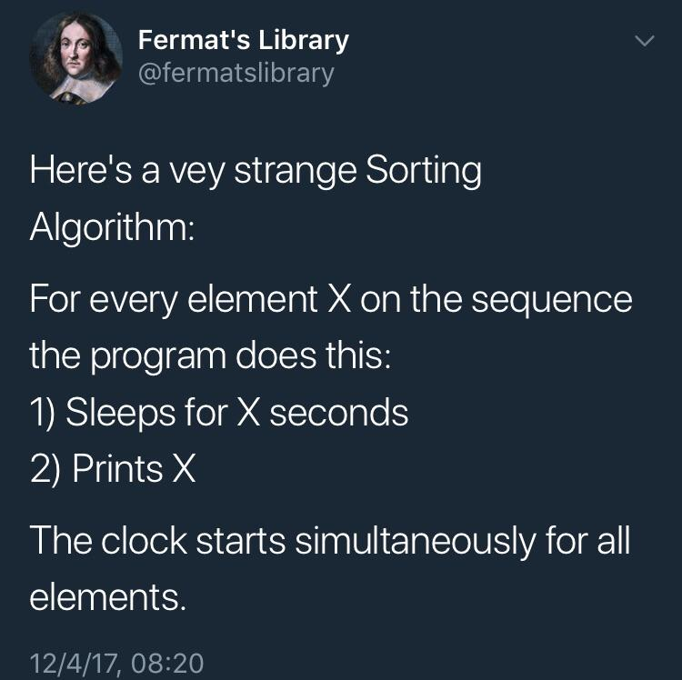
Sorting… how
Comparison criteria
Space - An in-place sort does not require any extra space to accomplish its task. Both insertion sort and shell sort are in-place sorts. Quicksort requires stack space for recursion, and therefore is not an in-place sort. Tinkering with the algorithm considerably reduced the amount of time required.
Time - The time required to sort a dataset can easily become astronomical.

Slide 20

Sorting… how
Comparison criteria
Simplicity - The number of statements required for each algorithm. Simpler algorithms result in fewer programming errors.

Slide 21

Bubble Sort
Why:
Bubble Sort is often taught in introductory computer science courses.
It is a relatively slow sort, but an inspiration for a better sorting algorithm.
Intuitive and general-purpose.

Slide 22
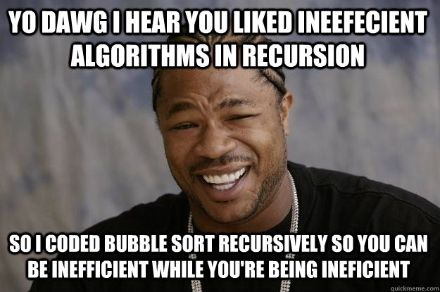
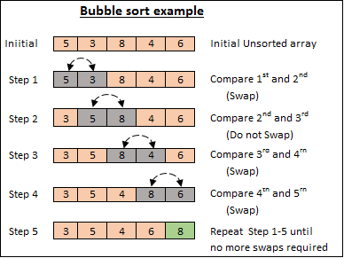
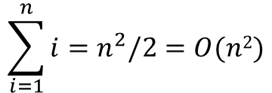
Bubble Sort
Why:
Easy to implement.
Can be easily parallelized.
On small, sorted arrays works fast.
$$\sum_{i=1}^{n}{{i=n}^{2}/2}=O(n2)$$

Slide 23

Quick Sort
Why:
Fast for big, unsorted arrays.
Multiple ways to implement.
Has a pivot.
But non-stable and not an in-place sort.
Cannot be parallelized.
Cannot do linked lists.

Slide 24
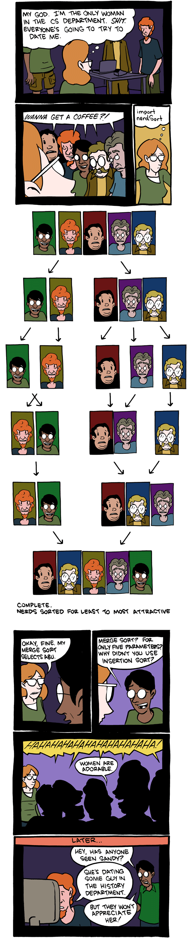
Merge Sort
Why:
It works. It’s stable. It’s general-purpose.
Can be parallelized.

Slide 25

Summary
 | Time
Sorting method | Avg. | Best | Worst | Space | Stability | Notes
Bubble Sort | O(n^2) | O(n^2) | O(n^2) | Constant | Stable | Always try to optimize it.
Quick Sort | O(n*logn) | O(n*logn) | O(n^2) | Depends | Stable | Randomly picking a pivot (or shuffle the array) can help avoiding WCS such as perfectly sorted arrays.
Merge Sort | O(n*logn) | O(n*logn) | O(n*logn) | Depends | Stable | On arrays, merge sort requires O(n) space; on linked lists - constant space

Slide 26
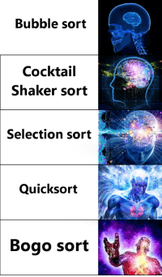
Homework
Bogosort
Cocktail shaker sort
Gnome sort
Pigeonhole sort
Proxmap sort
Radix sort
Timsort

Slide 27
Basic data structures
EA 2018

Slide 28
Data Structures
Data Structures
Built-in data structures
User-defined data structures
Integer
Float
Char
Pointer
Arrays
Lists
Files
Linear lists
Non-linear lists
Stacks
Queues
Graphs
Trees

Slide 29
Array
Definition: Contiguous block of memory locations, where each memory location stores one fixed-length data item. It could also mean a logical data type composed of a (typically homogeneous) collection of data items, with each data item identified by an index number:
collection of elements of similar datatype
contiguous memory allocation
each element can be accessed directly using position variable
array elements can be accessed individually
0
1
2
N
…
size
size
size
size
Problems with an array:
Array size is fixed
Unsorted array: searching for an item is slow
Sorted array: insertion and deletion is slow

Slide 30
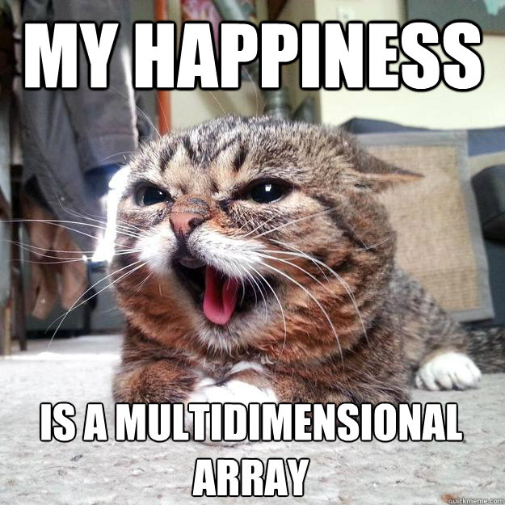
Array
Examples:
tables, especially lookup table - replaces runtime computation with a simpler array indexing operation.
The savings in terms of processing time can be significant, since retrieving a value from memory is often faster than undergoing an 'expensive' computation.

Slide 31

Linked list
A program designer should first consider what basic operations the implementation must support. Our common intuition about lists tells us that a list should be able to:
grow and shrink in size as we insert and remove elements.
to insert and remove elements from anywhere in the list.
to gain access to any element’s value, either to read it or to change it.
to create and clear (or reinitialize) lists.
to access the next or previous element from the “current” one.

Slide 32
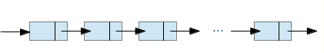
Linked list (Singly Linked List)
Definition: Finite, ordered sequence of data items known as elements. “Ordered” in this definition means that each element has a position in the list.
For simplicity all elements of the list should have the same data type
There is no conceptual objection to lists whose elements have differing
data types if the application requires it.
The operations defined as part of the list ADT do not depend on the elemental data type.
Definition: A list is said to be empty when it contains no elements.
Definition: The number of elements currently stored is called the length of the list.
Definition: The beginning of the list is called the head, the end of the list is called the tail.

Slide 33
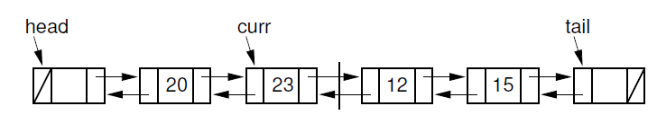
Doubly Linked List
Rule: A doubly linked list allows convenient access from a list node to the next node and also to the preceding node on the list.

Slide 34
Stack
Definition: List-like structure in which elements may be inserted or removed
from only one end.
Rule: While this restriction makes stacks less flexible than lists, it
also makes stacks both efficient and easy to implement.
AKA: “LIFO” list, which stands for “Last-In, First-Out”
100
87
87
87
20
20
20
15
15
15
12
12
12
7
7
7
Original contents
Pop
Push

Slide 35
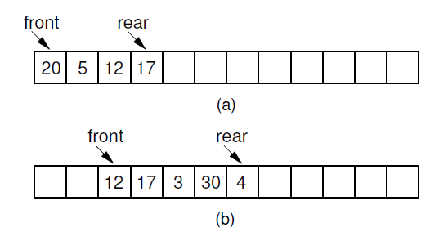
Queue
Definition: List-like structure that provides restricted access to
its elements.
Rule: Queue elements may only be inserted at the back and removed from the front.
AKA: “FIFO” list, which stands for “First-In, First-Out.
(a) The queue after the initial four numbers 20, 5, 12, and 17 have been inserted.
(b) The queue after elements 20 and 5 are deleted, following
which 3, 30, and 4 are inserted.

Slide 36
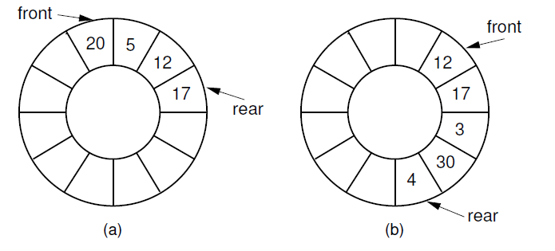
Circular Queue
(a) The queue after the initial four numbers 20, 5, 12, and 17 have been inserted.
(b) The queue after elements 20 and 5 are deleted, following which 3,
30, and 4 are inserted.

Slide 37
Binary trees
EA 2018

Slide 38
Trees
Defined recursively:
A single node S is a tree T with vertices V = {}, where S is the root of T
If N ∉ T is a node, P ∈ T and there is an edge (P, N) between P and N,
then T’ = T ∪ N, V’ = V ∪ (P, N) is also a tree and N is called a child of P
A node without “children” is called a leaf
The tree with root N is called a subtree of P
Root
12
T
P
3
24
N
-11
36
17
73
Leaf
38
Notes:
Undirected acyclic graph
Use cases – File structure, processes, hierarchy, xml, json, Huffman encoding,

Slide 39
Trees
The depth of a node N is equal to the length of the path from the root to N
The height of a tree is equal to the depth of the deepest leaf (the longest path from the root to a leaf)
h = 4
12
3
24
11
36
17
73
24
17
73
39

Slide 40
Binary tree
Every node has at most 2 children, called left and right subtrees
A non-empty binary tree T is balanced if:
The left subtree of T is balanced
The right subtree of T is balanced
The difference between the heights of the left subtree and the right subtree is not more than 1.
12
3
4
11
17
73
40
Notes:
Arithmetic expressions
Explain balancing factor

Slide 41
Binary tree - Traversals
Preorder (root, left, right)
Inorder (left, root, right)
Postorder (left, right, root)
41

Slide 42
Binary search tree
A binary tree, in which:
The key for every node is greater than or equal to the keys in the left subtree
The key for every node is less than or equal to the keys in the right subtree
Allows for fast lookup, addition and removal of items
12
3
24
-11
17
73
42
Notes:
Addition
Removal
Lookup
Create an unbalanced tree with sorted sequence

Slide 43
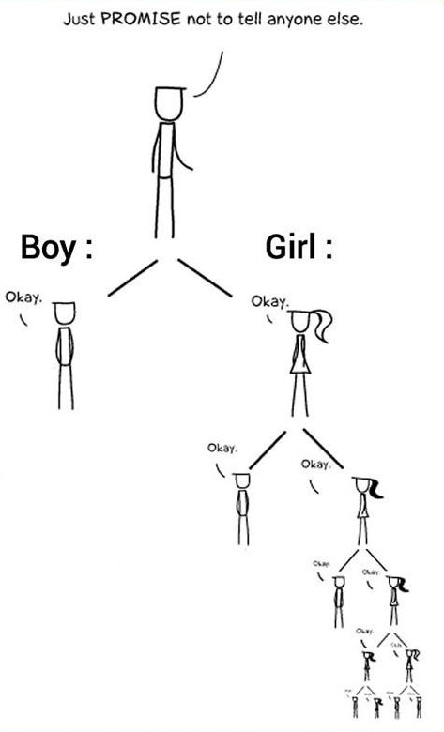
Why we need to balance?
43

Slide 44
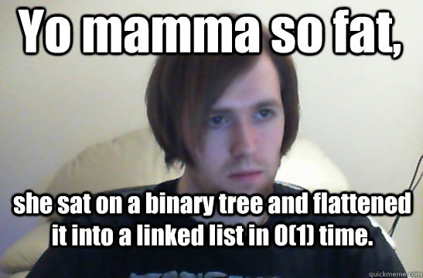
What’s flattening?
44

Slide 45
Tree flattening
Happens when a tree is so unbalanced that it becomes nothing more than a linked list
All the benefits of using a tree are gone
Self-balancing binary trees (AVL trees or red-black trees) are used as a countermeasure
12
24
73
17
45

Slide 46
AVL trees
A type of self-balancing binary search tree
The name comes from the inventors (Adelson-Velskii & Landis)
Has a perfect balancing
Constantly keeps track of the balancing factor and rebalances itself if needed
Guaranteed insertion, lookup and deletion with O(log n) complexity for n elements
12
12
12
3
24
3
24
-11
24
-11
17
73
-11
17
73
-14
3
17
73
-14
46

Slide 47
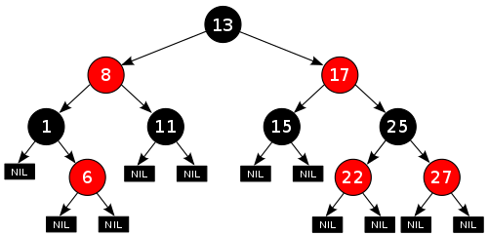
Red-black trees
A type of self-balancing binary search tree
Each element has a special bit, a.k.a color (red/black)
The balance of the tree is controlled using a set of criteria for the coloring of the nodes
Guaranteed insertion, lookup and deletion with O(log n) complexity for n elements
47

Slide 48
Red-black trees
Each node is either red or black
The root is black (for simplicity)
If a node is red, both of its children are black
Every path from a node to NIL contains the same number of “black” nodes
48

Slide 49
Searching algorithms
A search algorithm is the step-by-step procedure used to locate specific data (key) among a collection of data
Data extraction is critical for some applications
Fast search algorithm is very beneficial for the overall performance
The search speed is highly dependent on the data structure – Choose your data structures wisely
Notes:
Examples:
Extracting data for an order in a website
Getting user information in a social network

Slide 50

Searching algorithms

Slide 51
No algorithm is the best on its own! Pick the right tool for the job!

Slide 52
Commonly used search algorithms
Linear search
Binary search
Using a binary search tree

Slide 53
Searching – Linear search
Time complexity - O(n)
Trivial to implement
Iterates every element until key is found
Worst case: key is missing
key=11
1
5
-4
18
33
21
-98
13
-45
22
10
3
return false
key=21
return 5

Slide 54
Searching – Binary search
Time complexity – O(log n)
Requires the array to be sorted
Divides the array in half on every step and searches only the interval that might contain the key
Example: key = 13
key > 5
-98
-45
-4
1
3
5
10
13
18
21
22
33
key < 18
10
13
18
21
22
33
key > 10
10
13
18
key == 13
13
18
return 7
13
Notes:
WOW: If all the names in the world are written down together in order and you want to search for the position of a specific name, binary search will accomplish this in a maximum of 35 iterations.

Slide 55
Searching – Using a binary search tree
Time complexity – O(h), where h is the height of the tree
The complexity might become O(n) if the tree is skewed
Requires a binary search tree as a data container
Example: key = -4
key < 12
12
3
24
key < 3
-11
7
17
73
key > -11
-34
-4
21

Slide 56
Hash tables & Maps (Associative arrays)
What is an associative array?
What is hash table and why do we need it?
When to use hashes?

Slide 57
Associative array (Map)
Abstract data type
Composed of (key, value) pairs
A key may appear at most once in a map
Allowed operations are: pair addition, pair removal, pair modification and lookup based on key
Colors.add((Orange, #ffa500))
Colors : map
Blue
#00ff00
Blue
#00ff00
Green
#0000ff
Green
#ff0000
Orange
#ff0000
Red
#0000ff
Red
#ffa500
Notes:
Clubs -> 1
Diamonds -> 2
Hearts -> 3
Spades -> 4

Slide 58
Hash table
Implements an associative array
Operation have O(1) time complexity on average
Uses a “hash function” to compute a key, from which the desired element can be found
Ideally the hash function computes a unique key for every element
Usually collisions occur for some elements
Example: a phonebook
f(x) = x[0] // key is the first letter of the name
Cassie
Tim
Collin
Freddie
Nicolas
Pete
Victor
Anna
Brian
Otto
Tom
Zak
A
B
C
F
N
O
P
T
V
Z
Notes:
In a well-dimensioned hash table, the average cost (number of instructions) for each lookup is independent of the number of elements stored in the table. Many hash table designs also allow arbitrary insertions and deletions of key-value pairs, at (amortized^{[2]}) constant average cost per operation.^{[3][4]}

Slide 59
Hash table
A good hash function is essential for performance
A basic requirement is that the function provides a uniform distribution of the hash values
Non-uniform distribution means higher number of collisions
The hash function is sometimes evaluated using empirical data
Usually the key is calculated in 2 steps:
tmp = f(x)
key = tmp % N, where N is the size of the key space

Slide 60
Hash table – Use cases
Dictionaries
Databases
Caches
Sets
Object representation (Python, Ruby)
Cryptography
Github

Slide 61
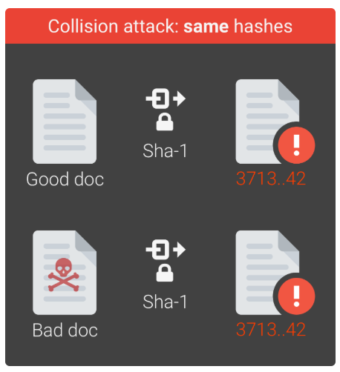
Secure Hash Algorithm (SHA)
Hard do deduct original content from the hash (password storage for websites)
Hard to find a different content with the same hash result
Prevents loading of malicious sites and applications
Debian software package authentication
Verifying transactions when dealing with cryptocurrencies, e.g. Bitcoin
Examples for SHA collision: https://shattered.it/
Notes:
Example with sha256 command in linux
Commitment example – Guess the number game

Slide 62

Graphs (not Grafs)
Definition
Algorithms
BFS traversal
DFS traversal
Minimum spanning tree
Dijkstra’s shortest path algorithm
Use-cases

Slide 63

Graph - Definition
A set of objects that are in some sense “related” (a really informal description is “circles, connected with lines”)
The objects are called vertices or nodes
The connections are called edges or arcs
Edges may be directed or undirected
Nodes that are connected with an edge are
called adjacent or neighbors
The practical uses are countless

Slide 64
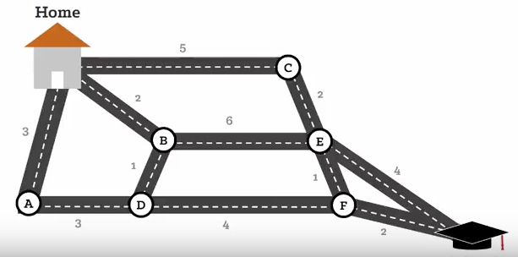
Weighted graph
Every edge is assigned a numerical value, called a weight or a price
Weighted graphs are used to model real-life scenarios, such as distances on a map or levels of difficulty
Notes:
Computer network with number of hops to another host

Slide 65
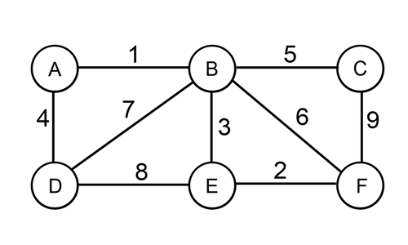
Spanning tree of a graph
A spanning tree of an unweighted graph G is a subset of G, which has all of G’s vertices with the minimum possible number of edges
A spanning tree of an weighted graph G is a subset of G, which has all of G’s vertices with the minimum possible sum of weights
Notes:
Prim and Kruskal’s algorithms

Slide 66
Cycles in a graph
There is a trivial path with length 0 from every node to itself (a loop)
A path in a graph is a finite sequence of edges which connect 2 vertices
The number of edges is called the length of the path
A cycle in a graph is a non-trivial path from n to itself

Slide 67
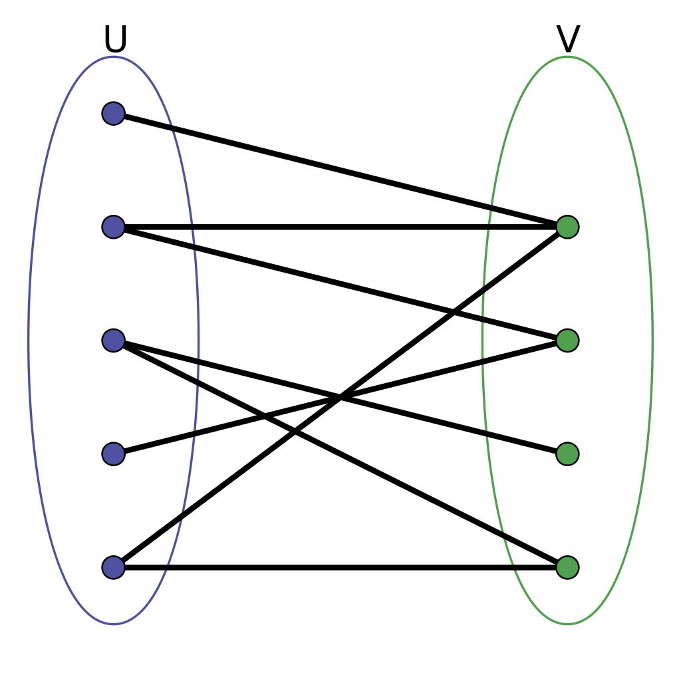
Bipartite graph
A graph whose vertices can be divided into 2 independent sets
Every edge is connected to one node in U and one node in V
Express relations between 2 different classes of objects
Widely used in social network analysis
Notes:
Football players <-> Clubs
Shops <-> Clients
Social network analysis – Meme spread by common interest, Common acquaintance, collaboration graph, etc.

Slide 68
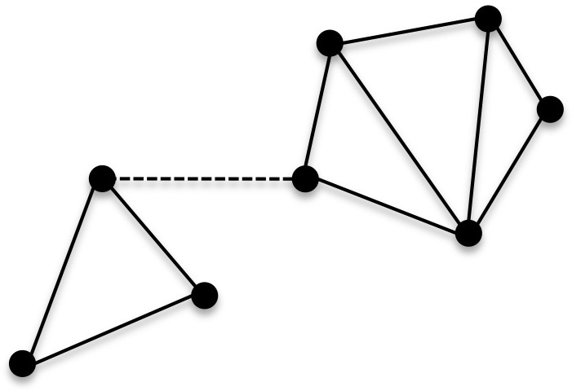
Connected and disconnected graphs
A graph is connected if there is a path between every pair of vertices
A connected graph has 1 connected component
A graph may be disconnected but have a number of connected components
Notes:
Reachable villages
Private network vs Internet

Slide 69
Breadth First Search (BFS) traversal algorithm
Initialize all nodes as “not visited”
Create an empty queue of nodes – Q and push the starting node in it
While Q is not empty:
Pop a node from the queue
Mark the popped node as “visited”
Push all of its neighbours into Q
The order of “visiting” is the order of the BFS traversal

Slide 70
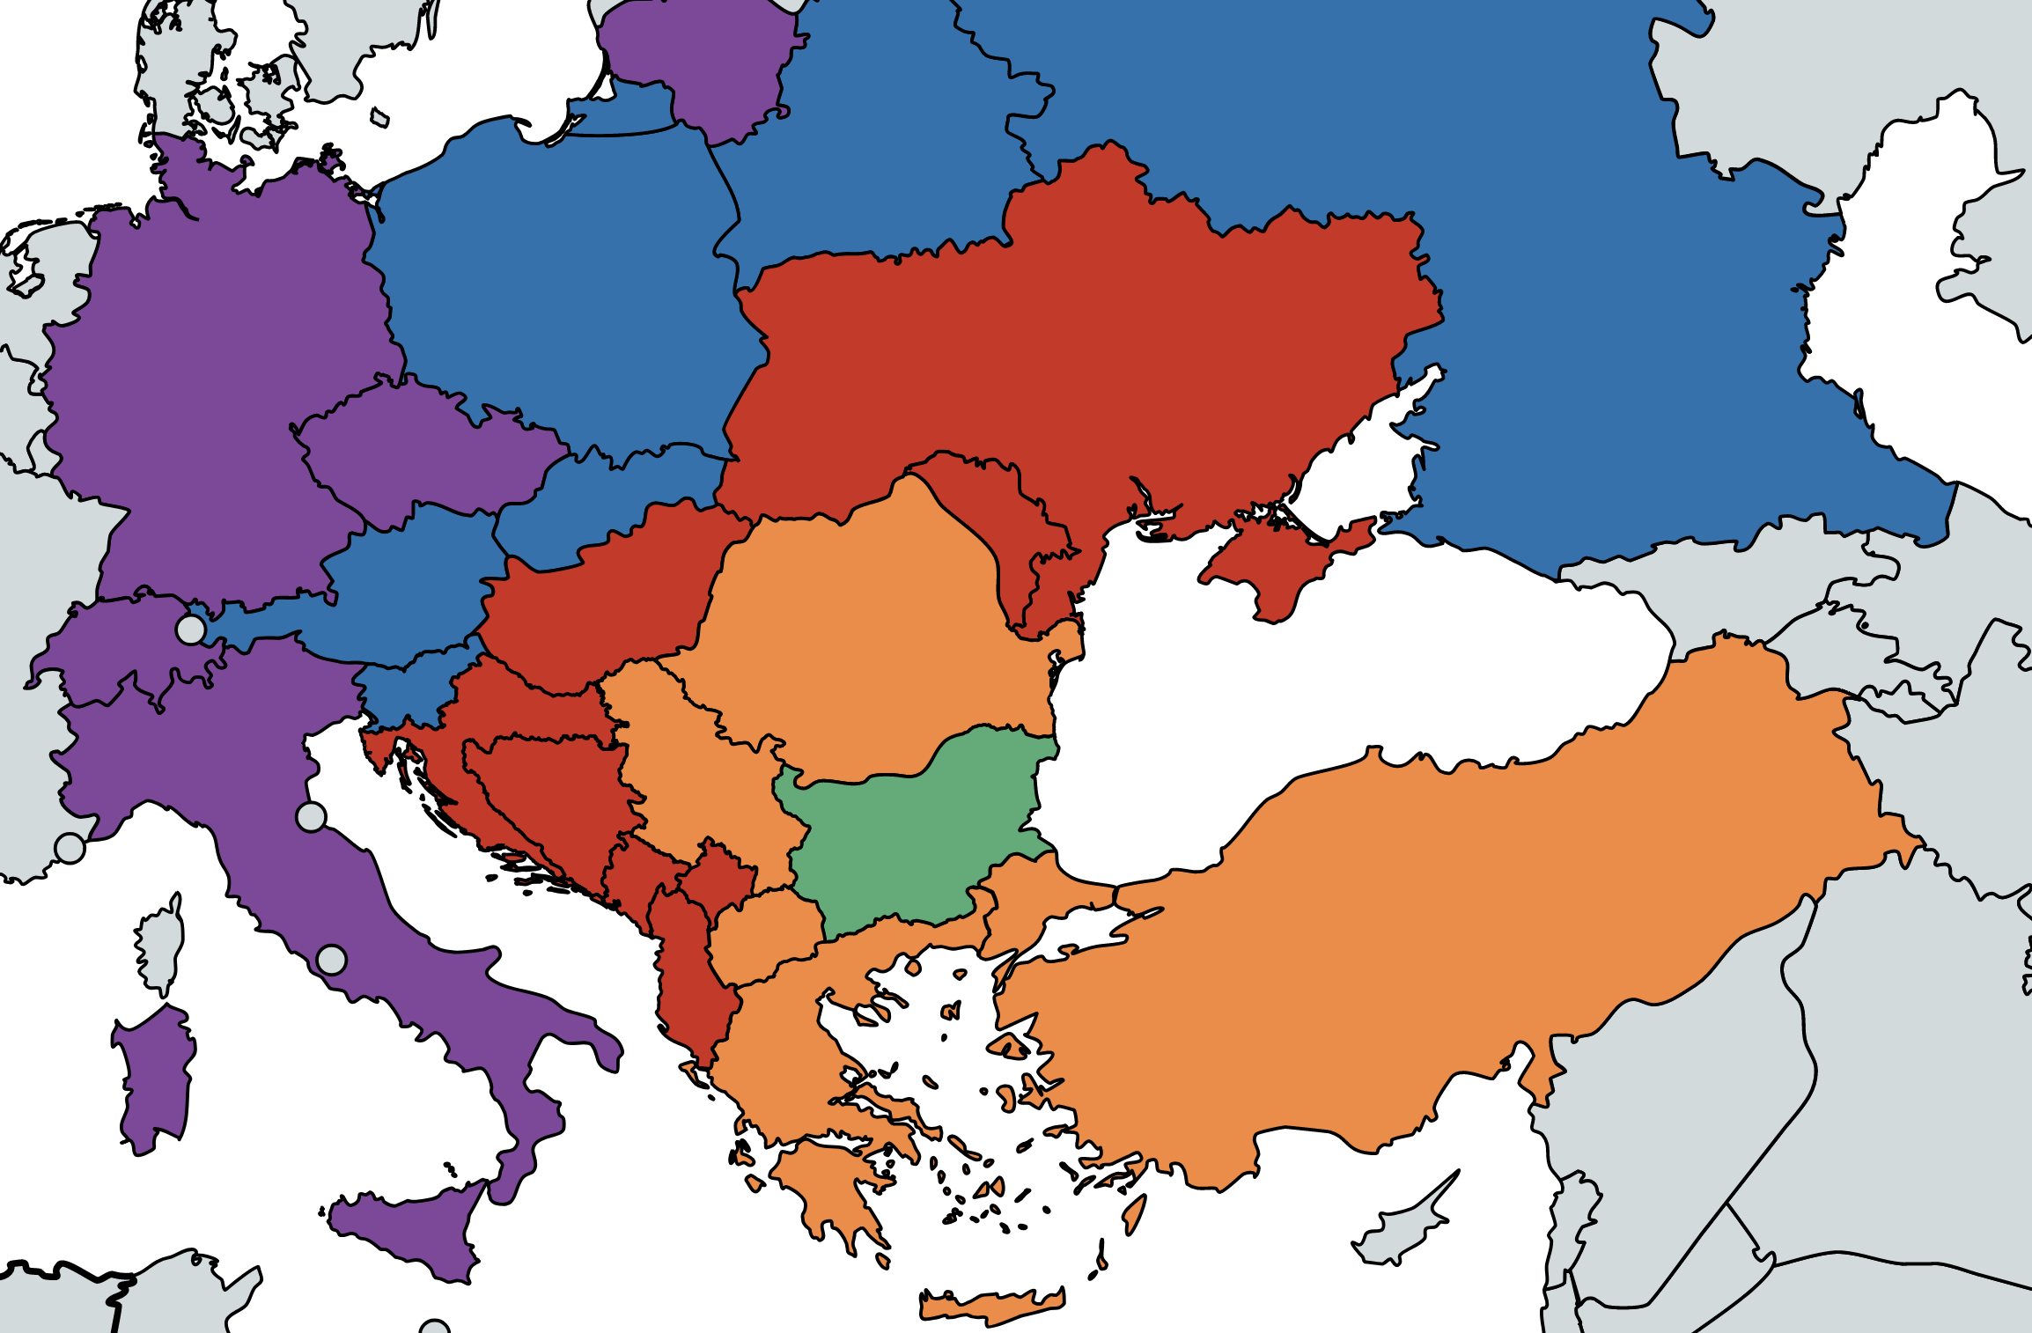
BFS traversal - applications
Gives the shortest path and the spanning tree for unweighted graph
Peer-to-peer networks (BitTorrent) – Finds the nearest neighbours
Social networking – Finds closest relatives
Broadcasting in network
A lot more

Slide 71

Depth First Search (DFS) traversal algorithm
Execute DFS(s)
Mark the starting node s as “visited”
For every “unvisited” neighbour node n, execute DFS(n)
Honestly, that’s it!

Slide 72
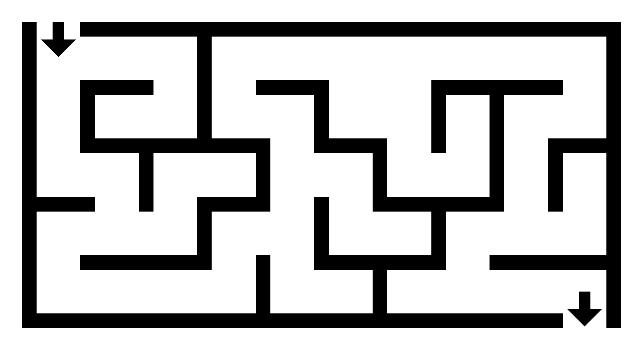
DFS traversal - applications
Solving puzzles with only one solution (Mazes)
Path finding
Detecting cycles in a graph
Minimum spanning tree for unweighted graph

Slide 73
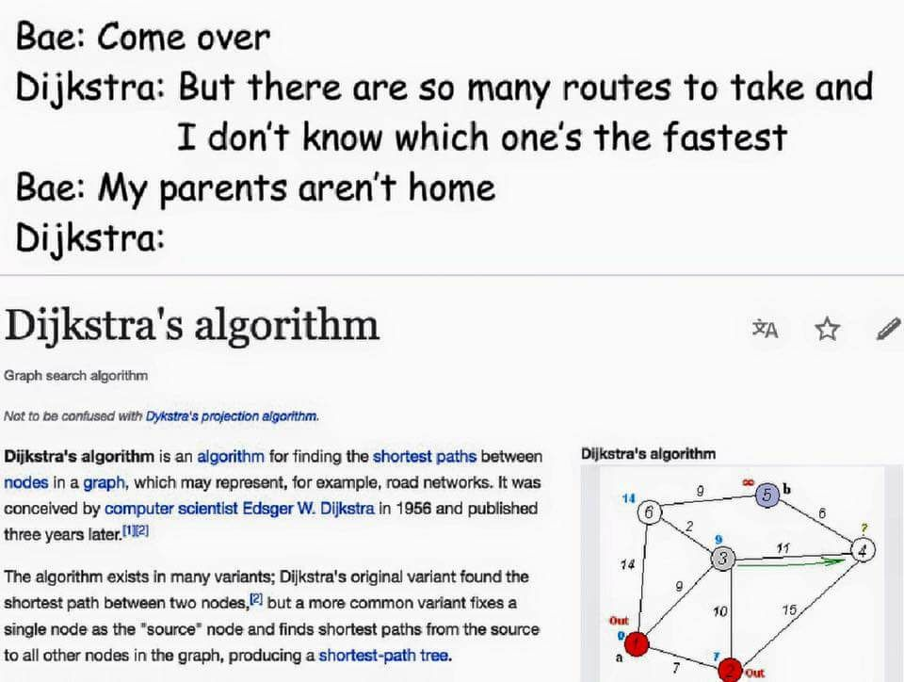
Dijkstra

Slide 74
Dijkstra’s algorithm for finding the shortest path
∞
5
∞
∞
2
∞
∞
∞
∞
∞
∞
3
∞
∞
5
5
7=5+2
8=2+6
2
2
7
11=7+4
∞
3
3 = 2+1
6 = 3+3
∞
3
3
7=3+4
8=7+1

Slide 75
Dijkstra’s algorithm for finding the shortest path
The result number stored for the target node is the shortest path
As a bonus, the algorithm also gives the shortest path to any node in between the starting node and the target node
Nodes with path as long as ∞ cannot be reached (disconnected graph)
5
2
7
11
9 = 7 + 2
3
3
7

Slide 76

Bonus: A* algorithm for finding the shortest path
Dijkstra’s algorithm
A* algorithm

Slide 77

Resources
dandree2@visteon.com
ktodoro2@visteon.com
Engineering Academy Crew

